Slide 1
State specific Water quality issues – Remedial measures
M.G.Cyriac

Slide 2
Water Quality Issues in Kerala State
1)Presence of coliform Bacteria
2)Variation in pH value a)Low pH and high pH
3)Excess Iron
4) Excess Turbidity
5)Excess Flouride
6) Salinity

Slide 3
Pollution due to organic matter
Excess hardness
Growth of Algae
Deposition of carbonate

Slide 4
Water Pollution
Point and non point sources of Pollution
Point sources-discharge from an industry, pollution from septic tank of a house etc
Non point sources of pollution,- Pollution of Flouride in Palakkad ,water logged area pollution in Alappuzha

Slide 5
Classification of the state based on water pollution potential
Water logged area
Coastal area
Thickly Populated Urban area ( towns , cities etc)
Thickly Populated Rural Area
Industrial area
Geographically specific area
Less populated rural area

Slide 6
Water logged area
Typically most part of Alappuzha district and small parts in other districts
Possibility for pollution is higher
Surface contaminants are having direct access to water bodies
Disposal of human excreta and other wastes are problem
Water contains high organic matter, excessive bacterial presence , turbidity, color, odour and such contaminants
Rain water harvesting is relevant to provide safe water but artificial recharge is not appropriate

Slide 7
Solutions
Construction of pucca septic tank with inlet and outlet above maximum water level
Reducing the wastes and its effective disposal
Biodegradable solid wastes to be converted as manure using vermi composting
Effective water supply system
Effective treatment even at the household level for to make water potable

Slide 8
Water Quality Issues in the Coastal Area
Sea water intrusion- Excessive withdrawal of fresh water results in to intrusion of sea water manifested as presence of excess Chloride ,Hardness etc
Predominant in most part of the coastal reach
Excessive presence of chloride , hardness and other minerals and brackisness in the water

Slide 9
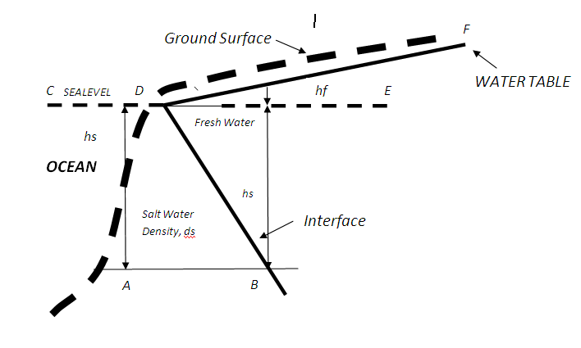
Ghyben- Herzsberg Equation

Slide 10
Treatments for Chloride
Removal
Reverse osmosis

Slide 11
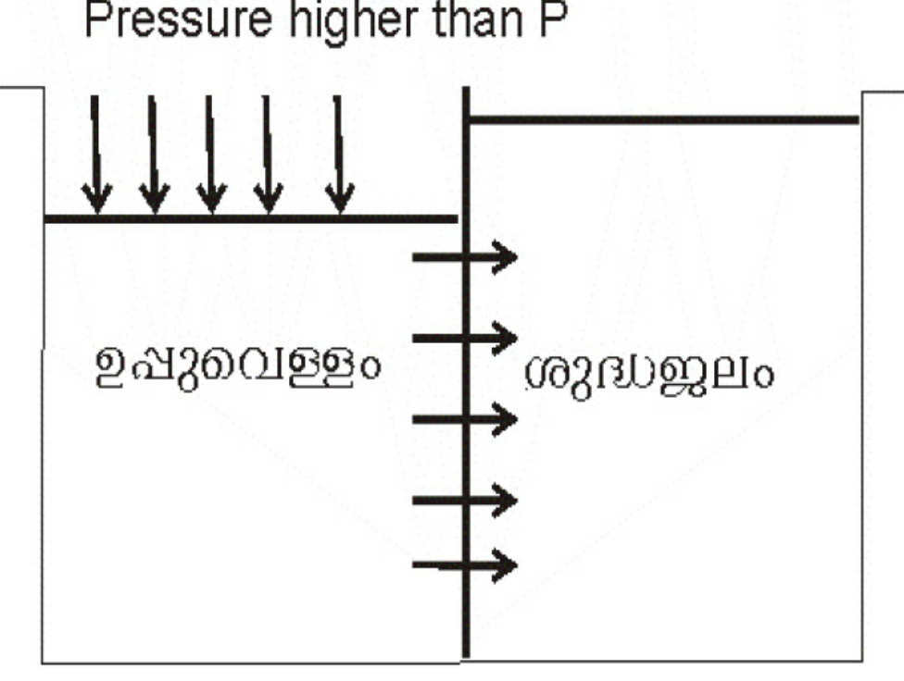

Slide 12
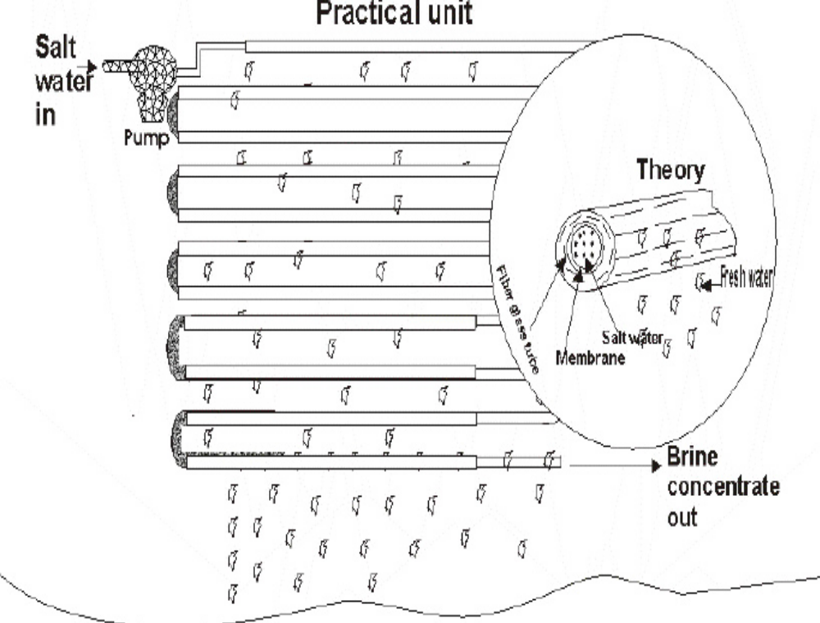
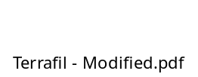

Slide 13
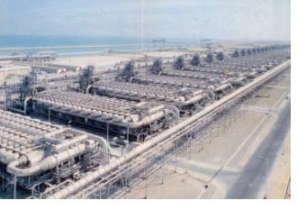
2500M3/Hour plant in Jubail, Saudi Arabia

Slide 14
Remedial measures
Rain Water harvesting
Limited depth of well to draw only fresh water
Other suitable measures to control of draining of fresh water to sea
Treatment of sea water using reverse osmosis
Predominant in Gulf countries

Slide 15
Thickly Populated Urban Area
In addition to resident population floating population will be enormous
If effective water supply is not available providing safe water to the people is challenging
Waste problem both liquid and solid will be serious
Generally the traditional water sources will be contaminated

Slide 16
General water quality issues
Presence of coliform bacteria
Presence of excess Iron in drinking water
Presence of organic matter
Low pH and in rare cases high pH
growth of algae
In most cases the pollution can be considered as non point exceptionally point sources of pollution

Slide 17
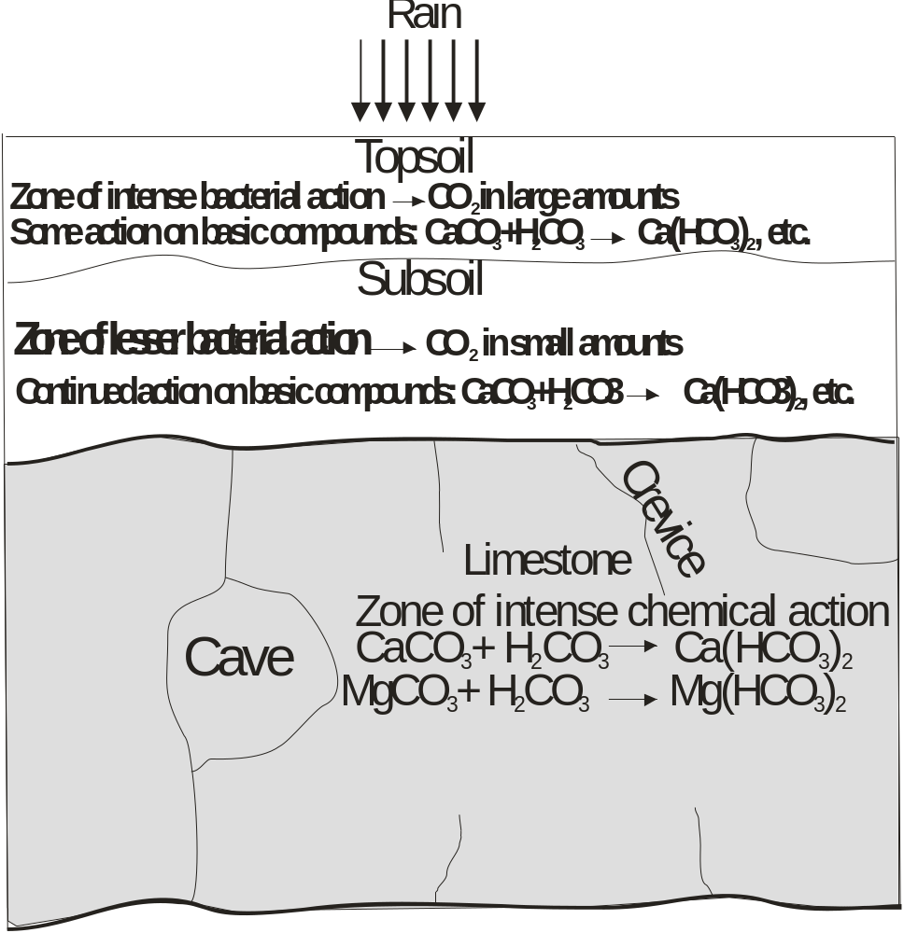
Water quality Variation while rain water is percolating through the earth

Slide 18
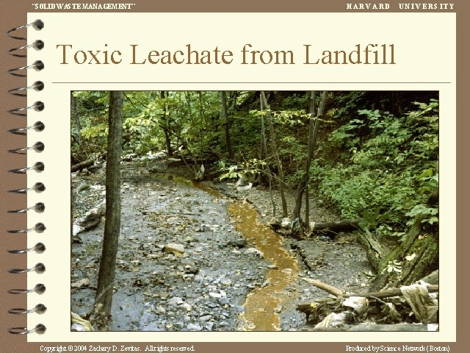

Slide 19
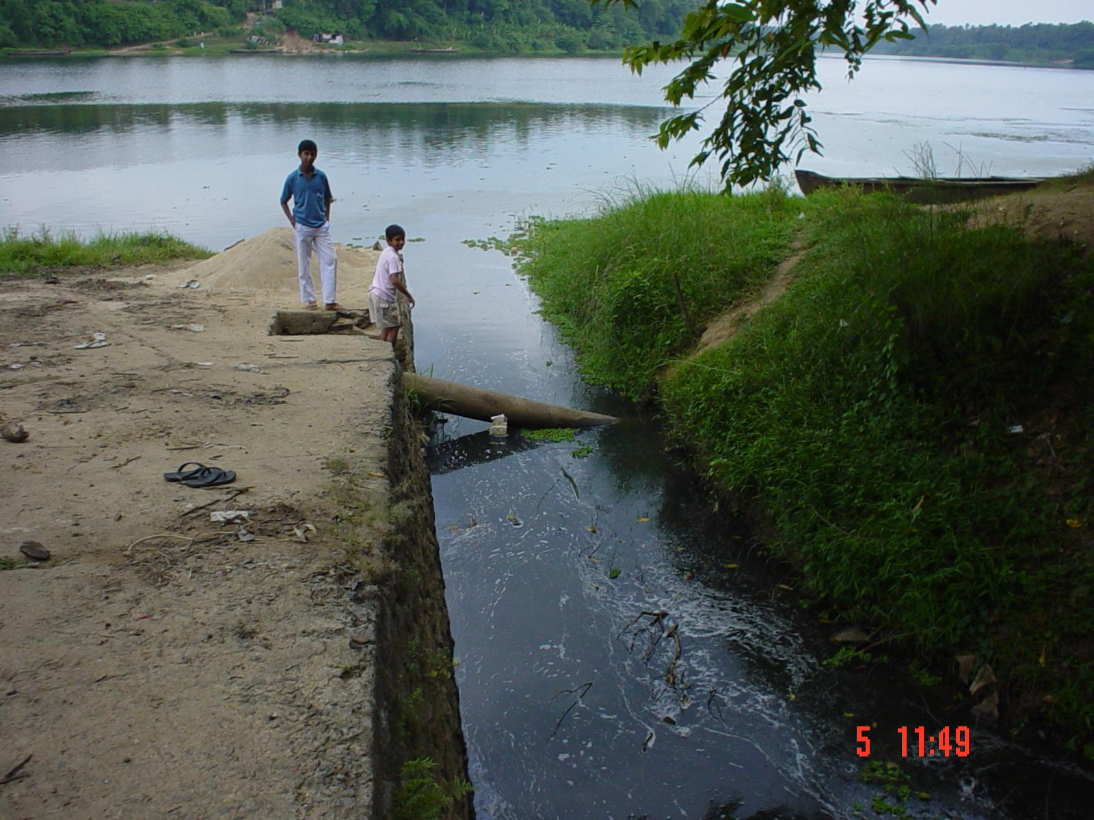

Slide 20
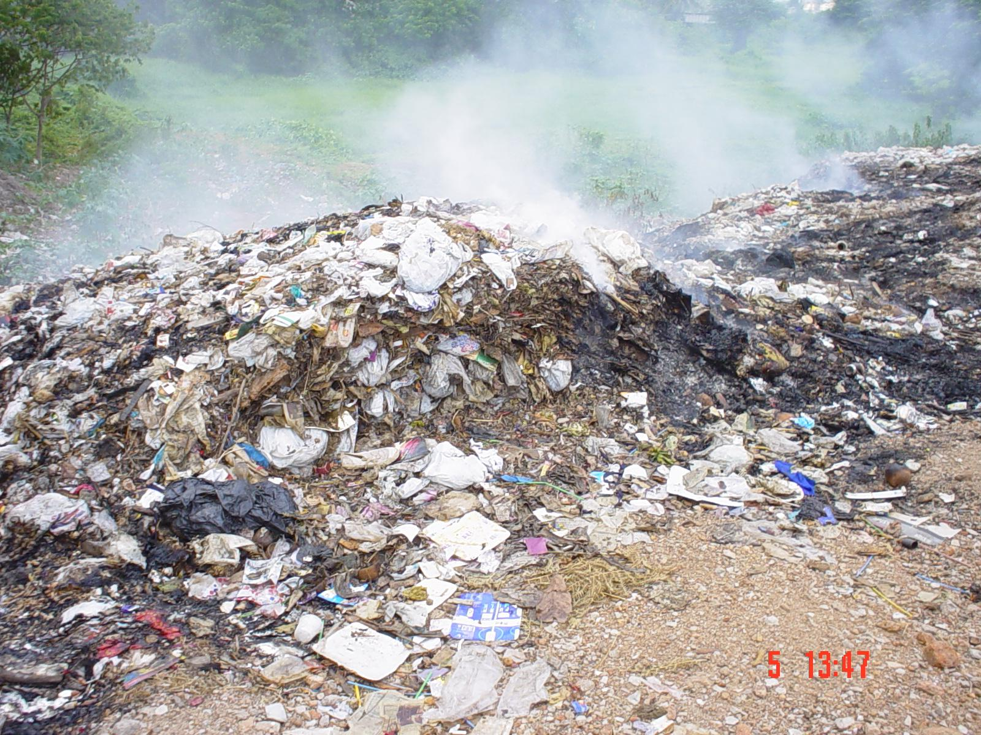

Slide 21
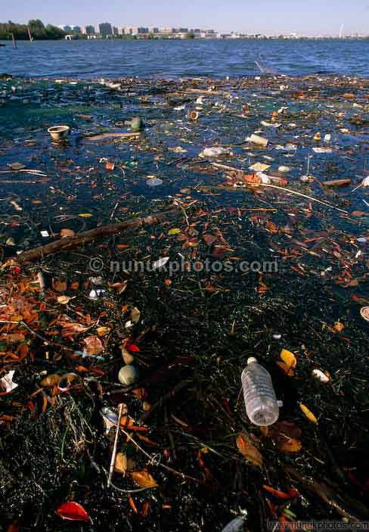

Slide 22
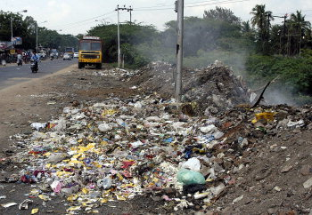

Slide 23
Thickly Populated Rural Area
Combined dependence on water supply and and other water sources like wells , borewells , tube wells , filterpoint etc
More than sixty lakhs of open wells are available in Kerala state
Effective maintenance of water supply and other water sources are relevant
Roof top Rain water harvesting and artificial recharge is relevant to control pollution and for sustainability of source

Slide 24
General water quality issues
Presence of coliform bactera
Presence of excess Iron in drinking water
Presence of organic matter
Low pH and in rare cases high pH
growth of algae
Pollution due to organic matter
In most cases point sources of pollution

Slide 25
Industrial Area
Pollution from discharge of industrial pollutants
Situation aggravates if the industrial wastes are not properly treated
The pollution depends on the type of industry and its waste products
Public opposition against such industries are common in our state
Artificial recharge reduces pollution

Slide 26
Remedial measures
Implementation of pollution control legislation-
Effective treatment of industrial wastes
Role of pollution control board is relevant

Slide 27
Geographically specific area
Alappuzha and Palakkad district having high content of Flouride
Ground water in certain area in palakkad district contains high content of chloride
Certain area in Thrissur district contains high sulphur content in soil which forms sulphate and thereby increases the acidityand reduces the pH
In addition to that so many irregular behaviors
Rain water harvesting and artificial recharge are advantageous

Slide 28
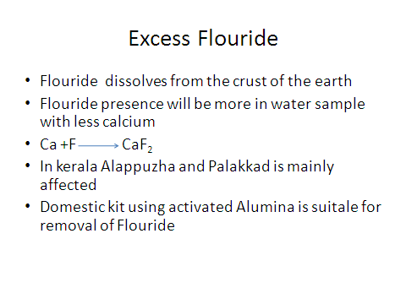
Excess Flouride

Slide 29
Less populated rural area
Generally refers to hilly terrain in the state
Generally the people are agriculturist
Houses are located in more area
Comparatively less polluted and healthy
generally open wells are the water sources
Well maintenance is more important Generally the water sources are deep
Rain water harvesting and artificial recharge improves availability of water ,improvement in agricultural activates
Occurrence of point sources of pollution

Slide 30
Presence of excess Iron
Iron constitutes 6% of the earth crust
3% in soluble Fe2+ form and 3% in insoluble Fe 3+ form
While rain water is percolated through the earth Fe2+ dissolves in the water

Slide 31
Bad effects of Iron
Change in colour when exposed to atmosphere ( oxidation of ferrous Iron to ferric Iron)-
Fe ²⁺ +O₂+H₂O Fe(OH)₃+H⁺
Excess requirement of milk to prepare tea of required flavor(Iron +Tanin = black colour)
Staining in vessels
Deposition of mud after the water is boiled
(More oxidation on heating)
Oily appearance on the surface of water

Slide 32
Treatment for removal of Iron from Drinking Water
Increase the pH of water by adding suitable alkaline materials ( lime , Soda ash, bleaching powder )
Aerate the water for oxidation to take place
Allow for settling and thereafter for filtering
Disinfect to make it potable

Slide 33
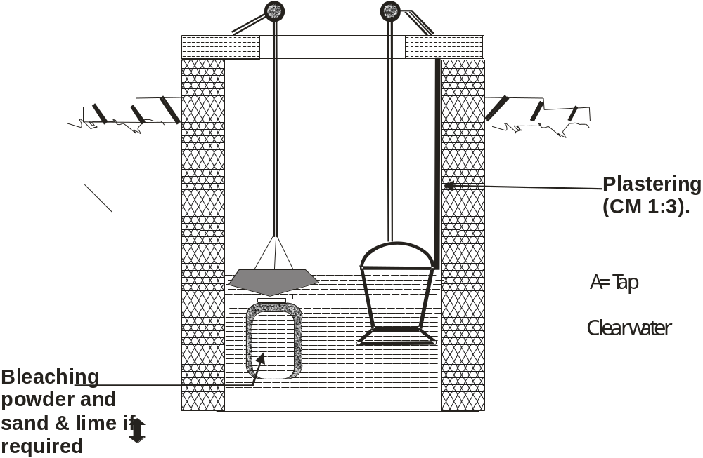
Removal of Iron in open wells

Slide 34
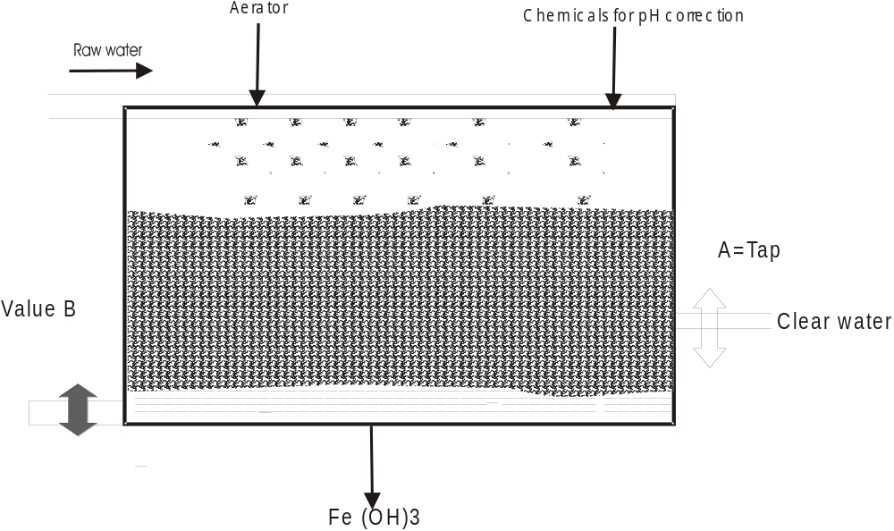
Excess Turbidity

Slide 35
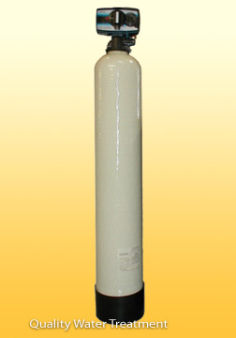
Iron removal using green sand,Iron specific resin,birm media

Slide 36
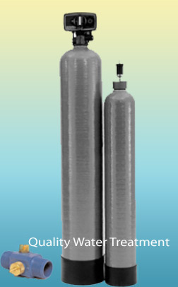

Slide 37
Terrafil technology for Iron removal
New method developed by IMMT Bhuvaneswar
Sand,clay and saw dust is mixed in a definite proportion
Thereafter it is moulded in the form of a circular disk
The disk is heated and the saw dust burns away and pores are formed
An iron removal system is arranged in such a way that
Iron containing water is filtered through the disk and the water gets treated

Slide 38
Terafil technology for water treatment prepare a filtering disk with the following proportion
Sl no | Materials | Percentage
1 | Pottery clay | 58
2 | Wood saw dust | 21
3 | River sand | 21

Slide 39
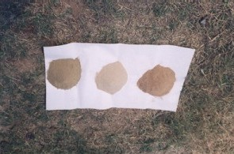
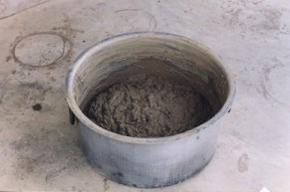
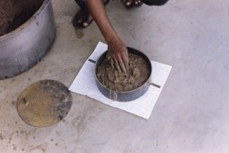
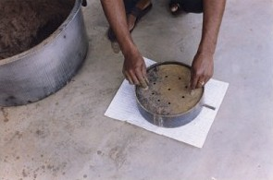
Production of TERAIL Media (Disc)
Sand, Saw dust & Clay
Mixed with water
Molding of Green Terafil

Slide 40
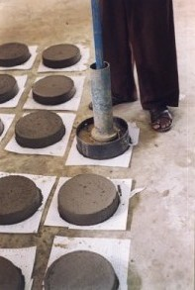
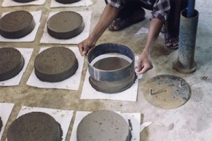
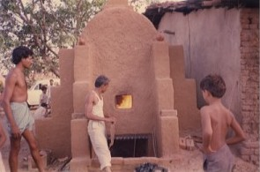
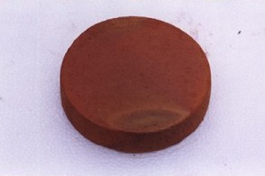
Green Terafil
Sintering of Terafil
Sintered Terafil
Construction of Terafil

Slide 41
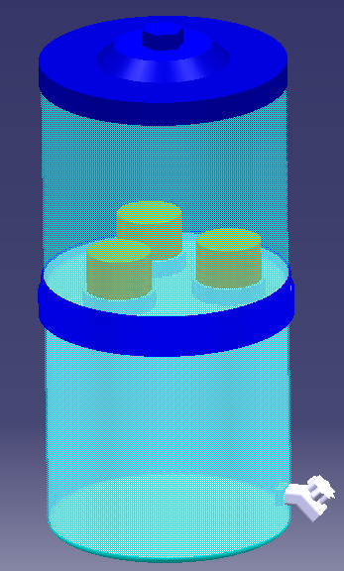
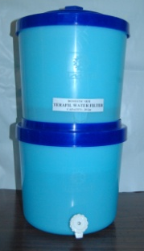
LID
TOP CONTAINER
TERAFIL
SUPPORT RING
BOTTOM
CONTAINER
TAP
TERAFIL WATER FILTER

Slide 42
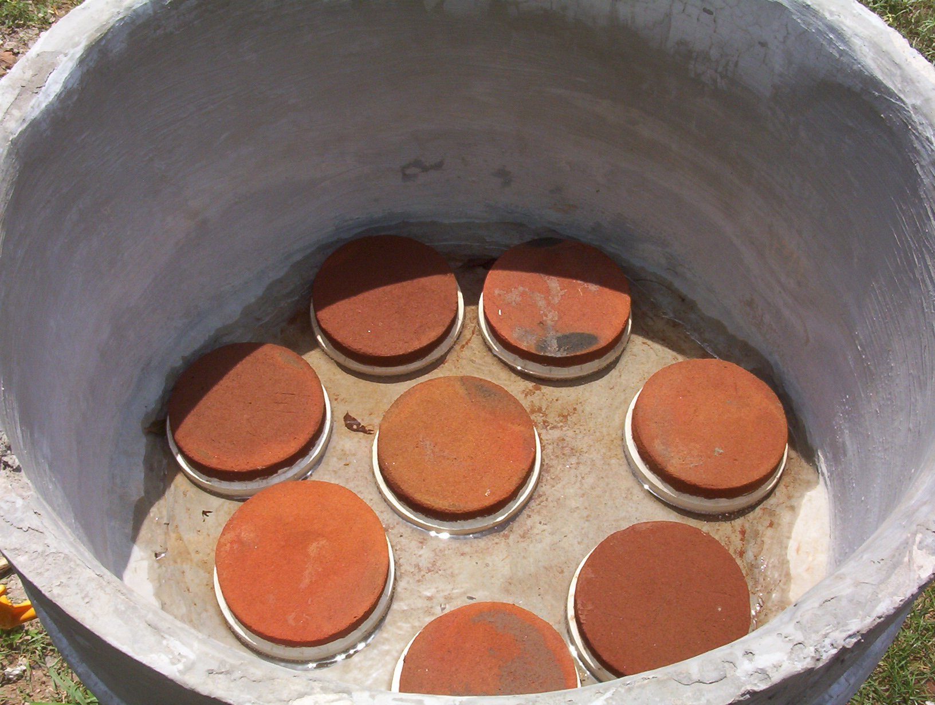
A model RCC Chamber for Terafil water filter
Notes:
42

Slide 43
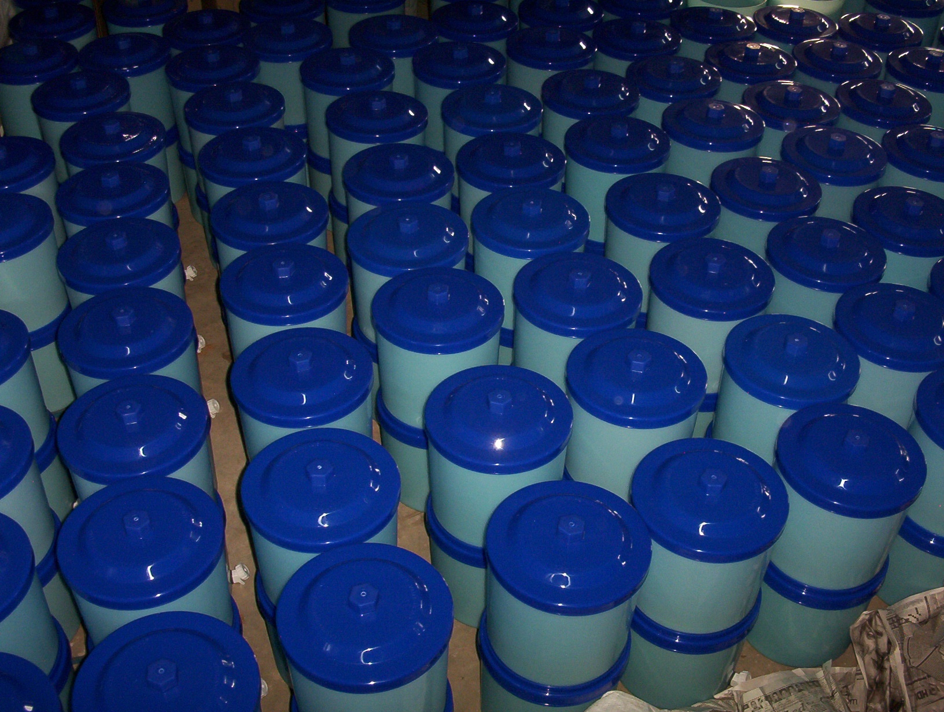
Assembled of Terafil water filter at IMMT, Bhubaneswar

Slide 44
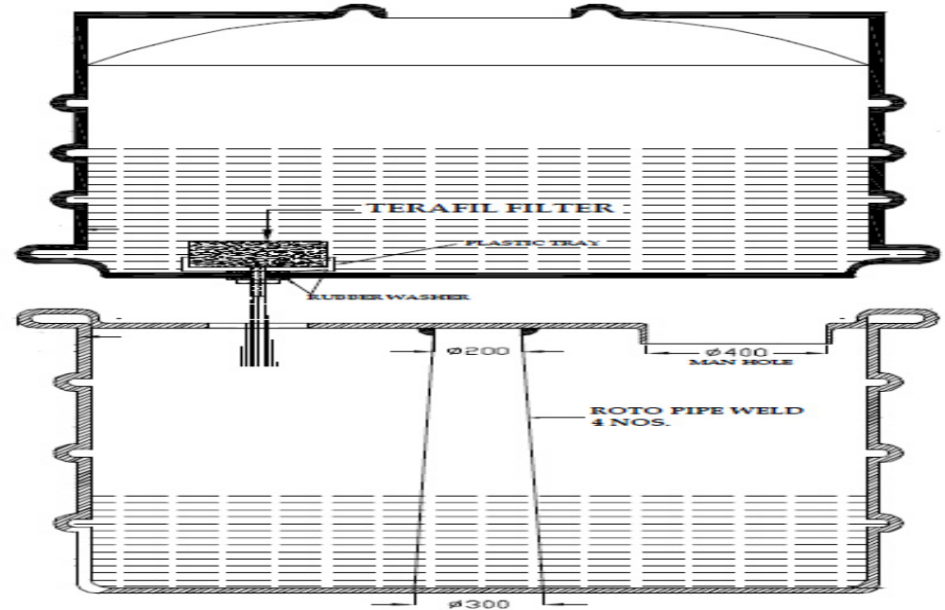

Slide 45
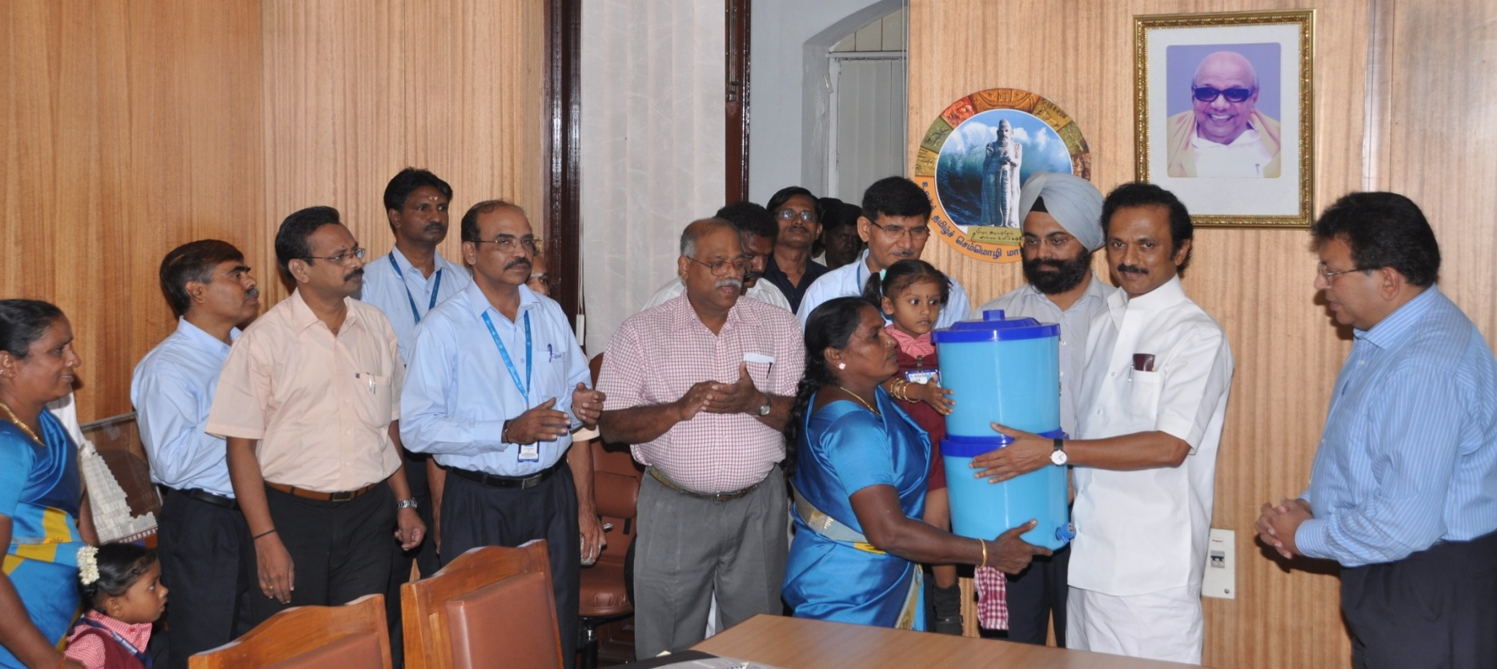
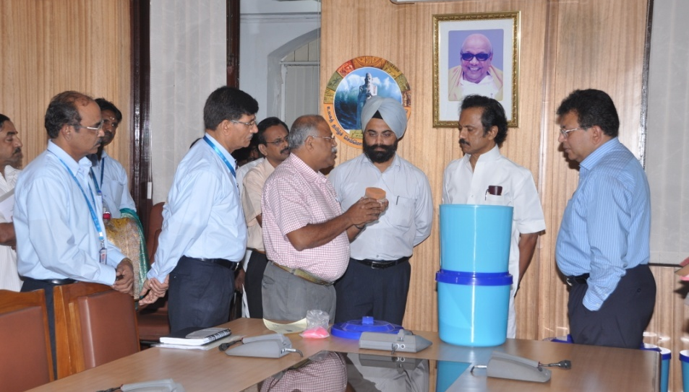
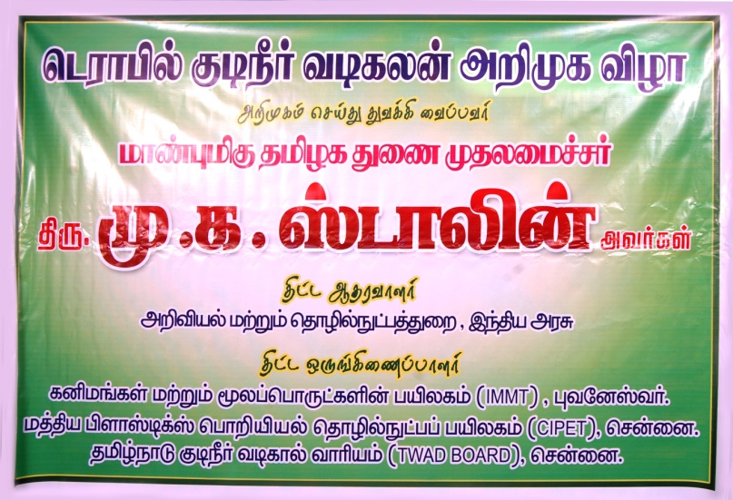
TERAFIL WATER FILTER launched by Hon’ble Dy. Chief Minister of Tamilnadu on 25th August 2010 at Chennai

Slide 46
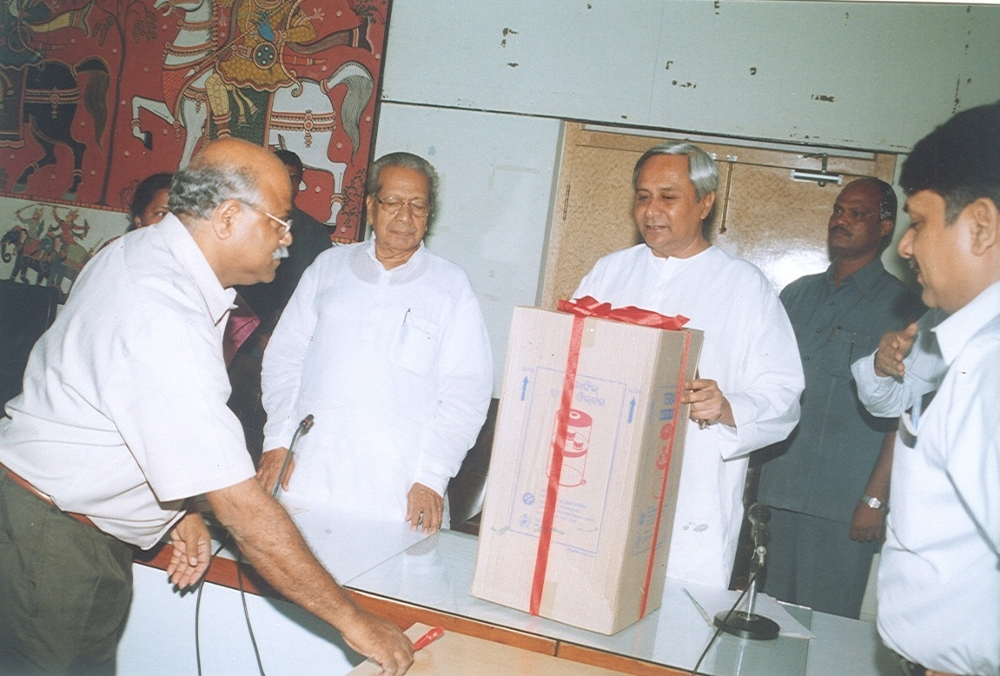
TERAFIL WATER FILTER launched by Hon’ble Chief Minister of Orissa on 10th August 2007

Slide 47
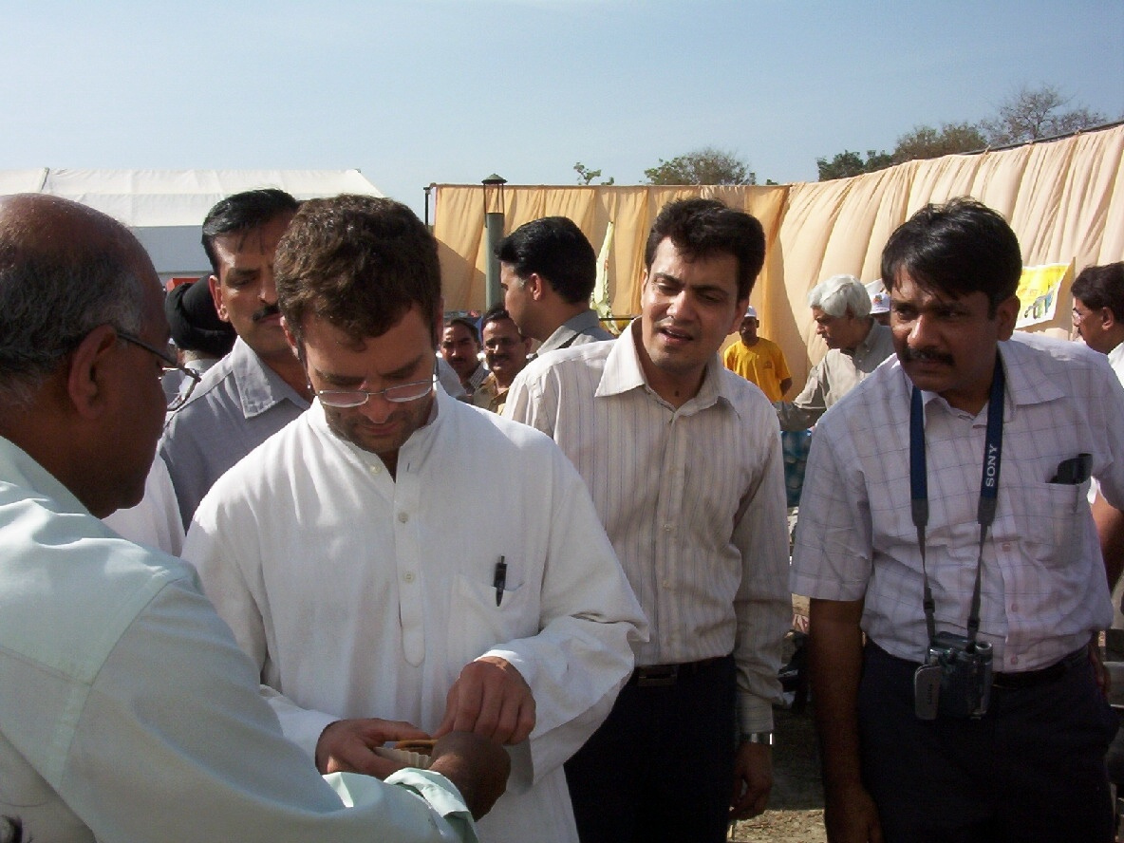
Inspection of IMMT technology by Hon’ble MP Sri Rahul Gandhi & Minister S&T, GOI Sri Kapil Sibal at Amethi, UP

Slide 48
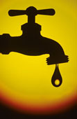
Thank you
Save drinking water

